Slide 1

Slide 1
Training

Slide 2
Slide 2
AGENDA
1. What is SQL?
2. What is SQL Server?
3. SQL Statements
4. Normalization
5. Denormalization
6. Indexes
7. Function
8. Store Procedure

Slide 3
Slide 3
What is SQL?
- Structured Query Language.
3

Slide 4
Slide 3
What is SQL Server?
- Relational Database Management System – RDBMS.
4

Slide 5
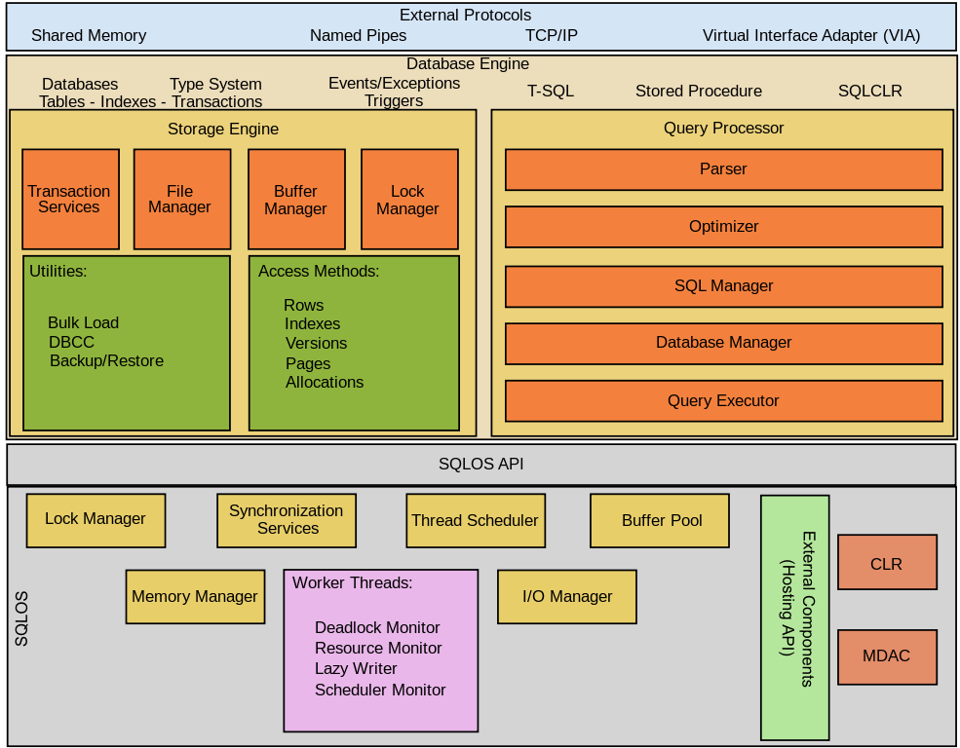
Slide 3
Structure of SQL Server

Slide 6
Slide 3
SQL Statements
DDL
CREATE
ALTER
DROP
DML
SELECT
INSERT
UPDATE
DELETE
DCL
GRANT
REVOKE
5

Slide 7
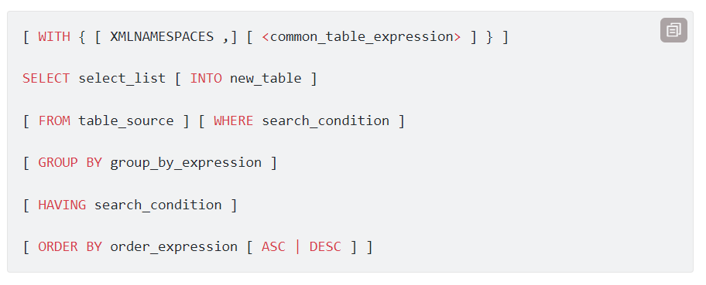
Slide 3
Order of execution for SQL statements
5

Slide 8
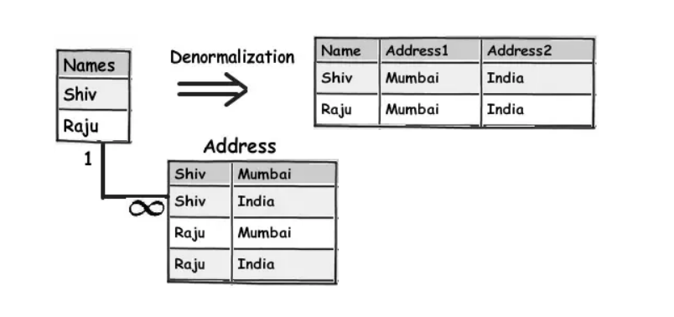
Slide 3
Normalization
5

Slide 9
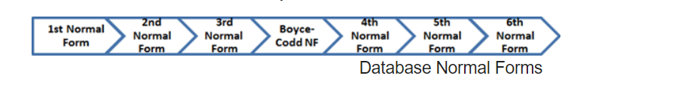
Slide 3
Normalization
1NF (First Normal Form)
2NF (Second Normal Form)
3NF (Third Normal Form)
BCNF (Boyce-Codd Normal Form)
4NF (Fourth Normal Form)
5NF (Fifth Normal Form)
6NF (Sixth Normal Form)
5

Slide 10
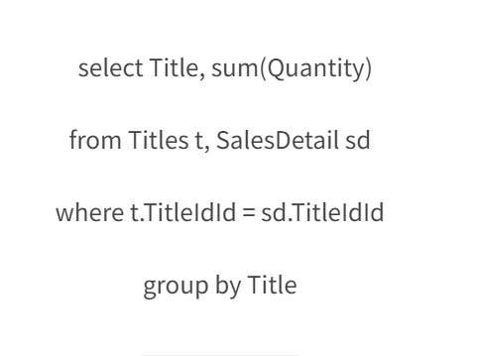
Slide 3
Denormalization
5

Slide 11
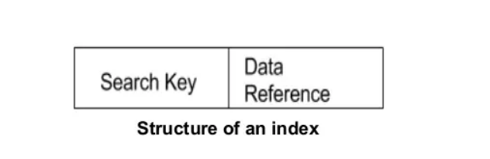
Slide 3
Indexes
Index is a data structure used to locate and quickly access data in database tables
Index is a way to optimize database query performance by reducing the amount of memory access when executing the query
5

Slide 12
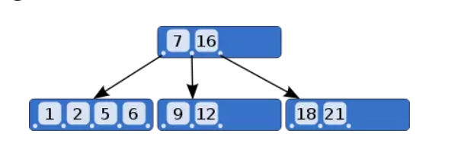
Slide 3
B-Trees

Slide 13
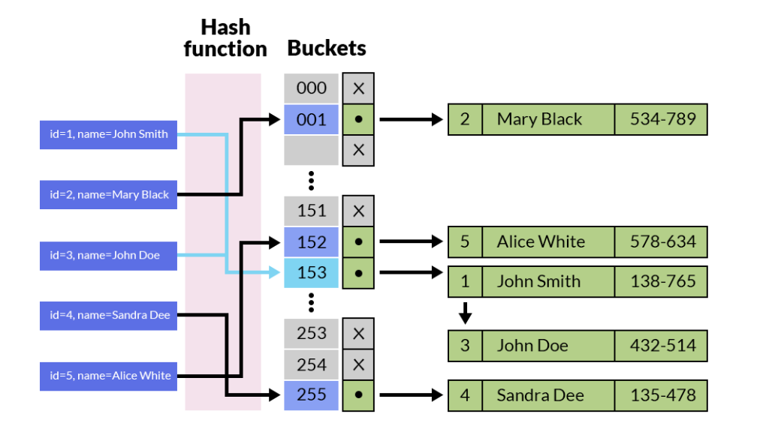
Slide 3
Hash index

Slide 14
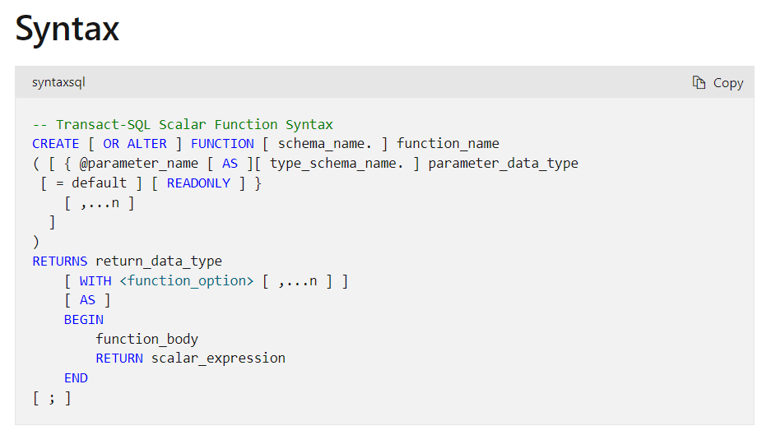
Slide 3
Function
5

Slide 15
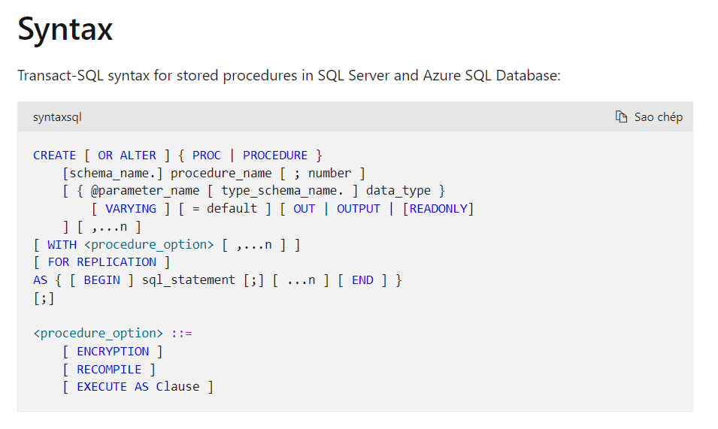
Slide 3
Store Procedure

Slide 16
Q&A

Slide 17
Thank You

